Slide 1



Listening in Noisy & Distracting Acoustic Environments for Autistic Adults
Science of Autism → Friday, December 13th, 2024
Peter A. Wasiuk, Au.D., Ph.D., CCC-A
Assistant Professor
Department of Communication Disorders, Southern Connecticut State University

Slide 2
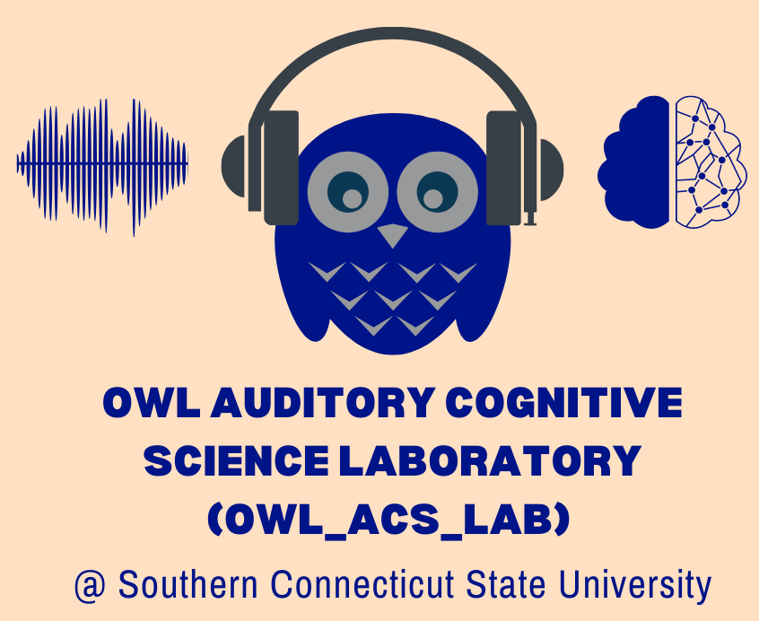
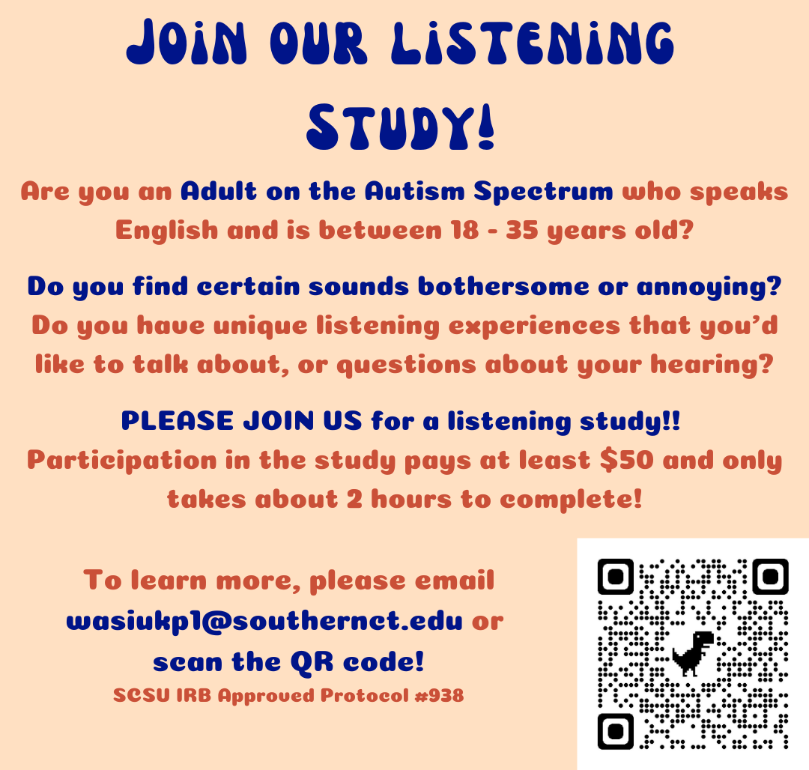

Please feel free to contact me!
Email → Wasiukp1@southernct.edu
SCSU webpage → https://www.southernct.edu/directory/wasiukp1
Lab webpage → https://www.auditory-cognitive-science.com/contact
Dr. Peter A. Wasiuk, AuD, PhD, CCC-A
Assistant Professor @ SCSU
Department of Communication Disorders

Slide 3
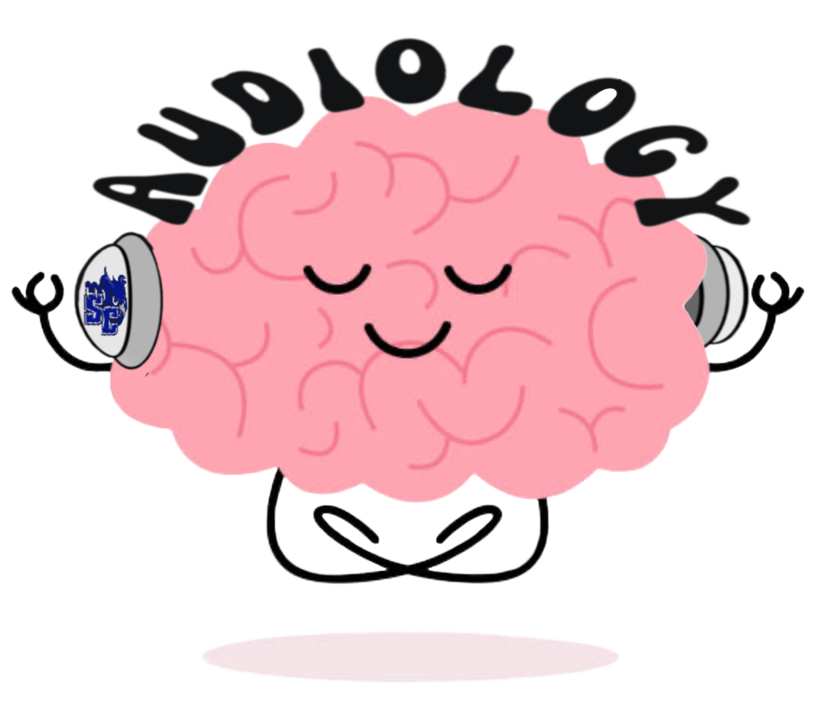

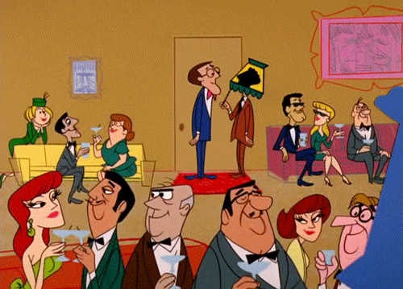

Background →
Listening in “Adverse” Acoustic Environments
I’m having a hard time following conversation & it’s stressing me out…
I guess I should go home & disengage 😞 😞
That’s the speech signal I was trying to listen to ☺
This is a great conversation!
Huh ?????

Slide 4


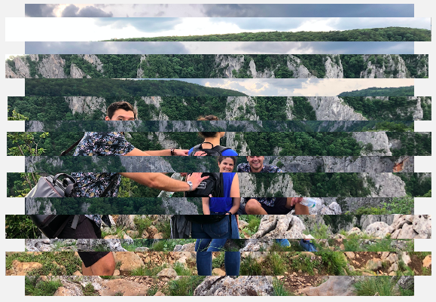

Background → Listening in Adverse Acoustic Environments
Energetic Masking
(EM)
Informational Masking
(IM)

Slide 5

Background → Listening in Adverse Acoustic Environments
“Glimpsed Representation of Target Speech”
Energetic Masking
(EM)
“Speech-in-noise”
recognition

Slide 6
Background → Listening in Adverse Acoustic Environments
“Glimpsed Representation of Target Speech”
Information Masking
(IM)
“Speech-in-speech”
recognition

Slide 7
“Speech-in-noise”
recognition
Cognitive Resource Demands & Effortful Listening
“Speech-in-speech”
recognition
Successful speech-in-noise &
speech-in-speech recognition requires significant
cognitive resource engagement
&
listening effort!!

Slide 8

Background → Cognitive Effort & Listening-related Fatigue
Adverse Acoustic Environments
Greater Cognitive Engagement &
Listening Effort
Higher Listening-related Fatigue
Listening situations with:
Competing talkers (i.e., high degrees of IM)
“Auditory Distraction”
Loud and/or bothersome noise
Selective attention to target speech & inhibition of masker (competing sound(s))
Auditory stream segregation
Linguistic knowledge
Sustained listening effort can lead to:
Increased Stress
Avoidance of Noisy Situations
Social Withdrawal
Poorer Quality of Life

Slide 9
Listening Difficulties in Adverse Acoustic Environments represent the most common complaint of individuals seeking care in audiology clinics…
For example, speech recognition difficulties in competing speech & noise are pervasive for →
Children and adults with sensorineural hearing loss
Aging adults with clinically “normal” hearing
Young children
Bilingual individuals (particularly when listening in non-dominant language)

Slide 10
Yet… little work has been done to acknowledge or address listening difficulties in adverse environments for Adults on the Autism Spectrum…
Recent qualitative reports indicate that many autistic adults experience persistent difficulties understanding speech & following conversation in adverse communication environments (e.g., Bendo et al., 2024; Sturrock et al., 2022)
Autistic adults indicate that their listening difficulties have widespread negative impacts on quality of life →
Significant stress surrounding communication in noisy and distracting environments (particularly in the presence of competing voices…)
Negative impacts on social interaction & participation, as well as on academic & vocational success
Limited awareness of these challenges among communication partners, institutions, and clinicians further exacerbate these negative impacts

Slide 11
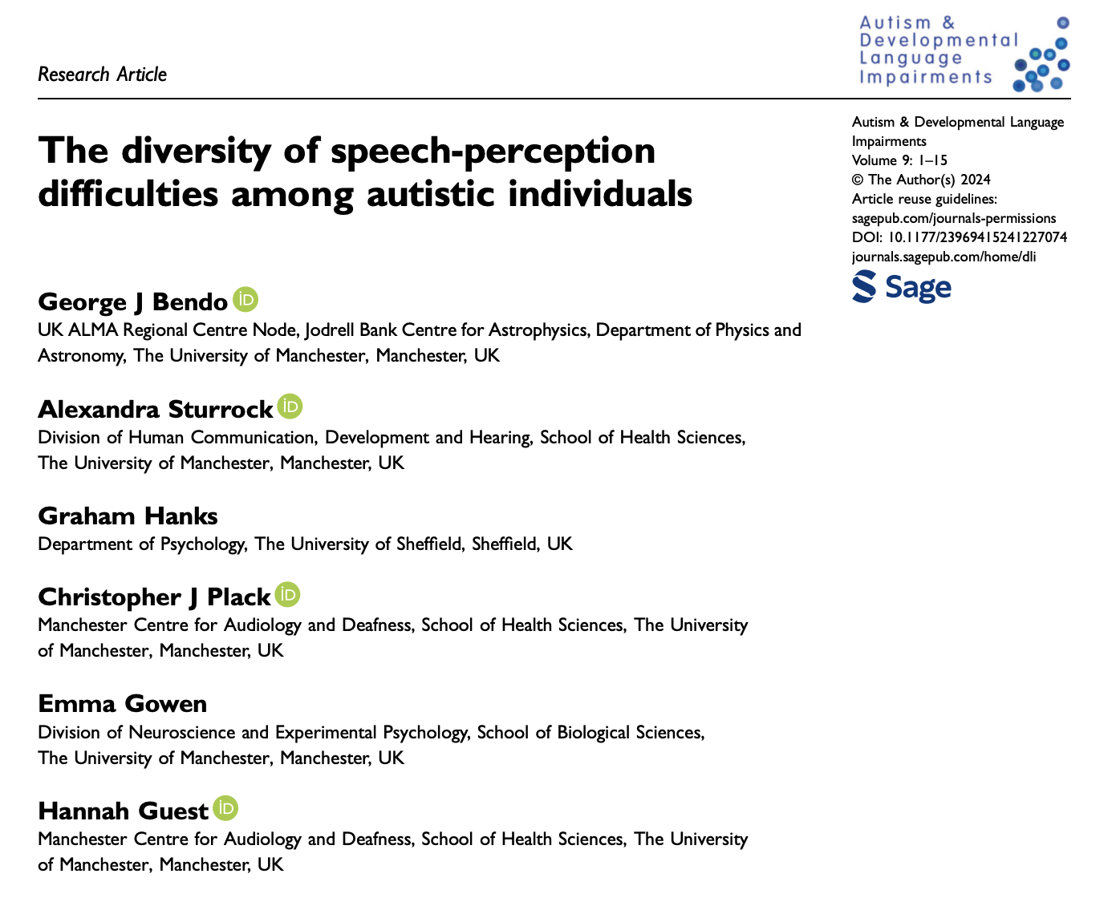
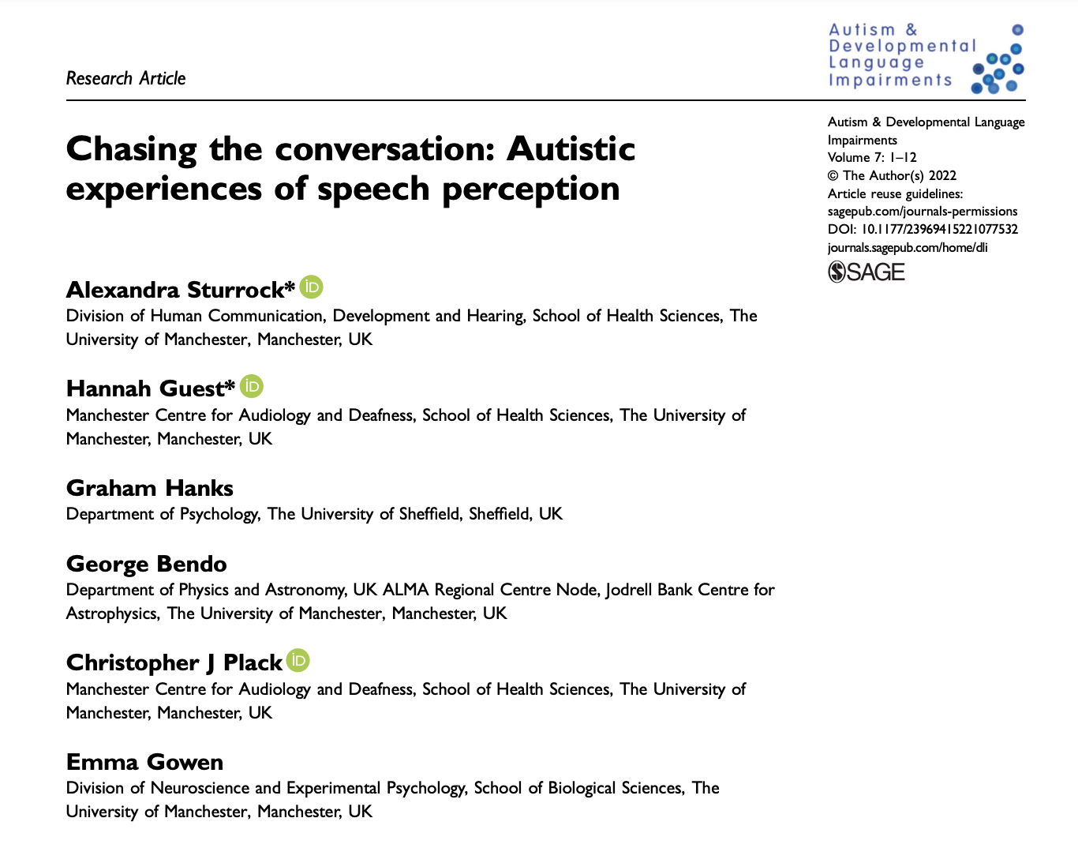
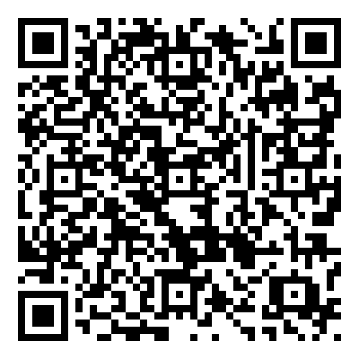
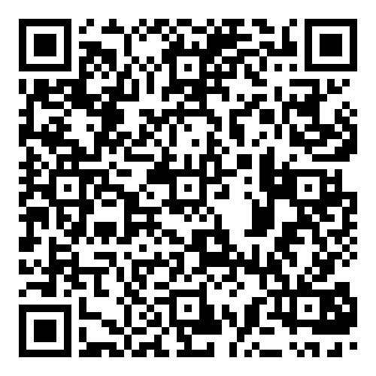
Autistic adults report pervasive speech understanding difficulties in daily life (Sturrock et al., 2022), with competing speech being particularly deleterious to their communication function & social participation (Bendo et al., 2024)
Adults on the autism spectrum report the subjective sense that their challenges following conversation in adverse environments are greater than those experienced by age-matched non-autistic peers (Bendo et al., 2024)

Slide 12
Important Aside → Differentiating Listening Difficulties in Adverse Environments & Decreased Sound Tolerance (DST)
Decreased Sound Tolerance (DST) & experiences of sensory overload in response to sound have long been associated with autism across the lifespan (see Williams et al., 2021; Poulsen et al., 2024 for recent reviews)
DST, or an inability to tolerate everyday sounds, is one of the most prevalent, persistent, and disabling sensory features associated with the autism spectrum
Hyperacusis → the perception of everyday sounds as excessively loud or painful… increased sensitivity or decreased tolerance to sound at levels that do not bother most non-autistic/neurotypical people
Misophonia → an acquired aversive reaction to specific sounds… excessive emotional responses to specific “trigger” sounds (e.g., chewing), even when presented at a low level… may also occur in specific situations with specific sound sources
Phonophobia → a fear of specific sounds… an acquired phobia of specific sounds or classes of sound that result in anticipatory fear responses or avoidance behaviors

Slide 13
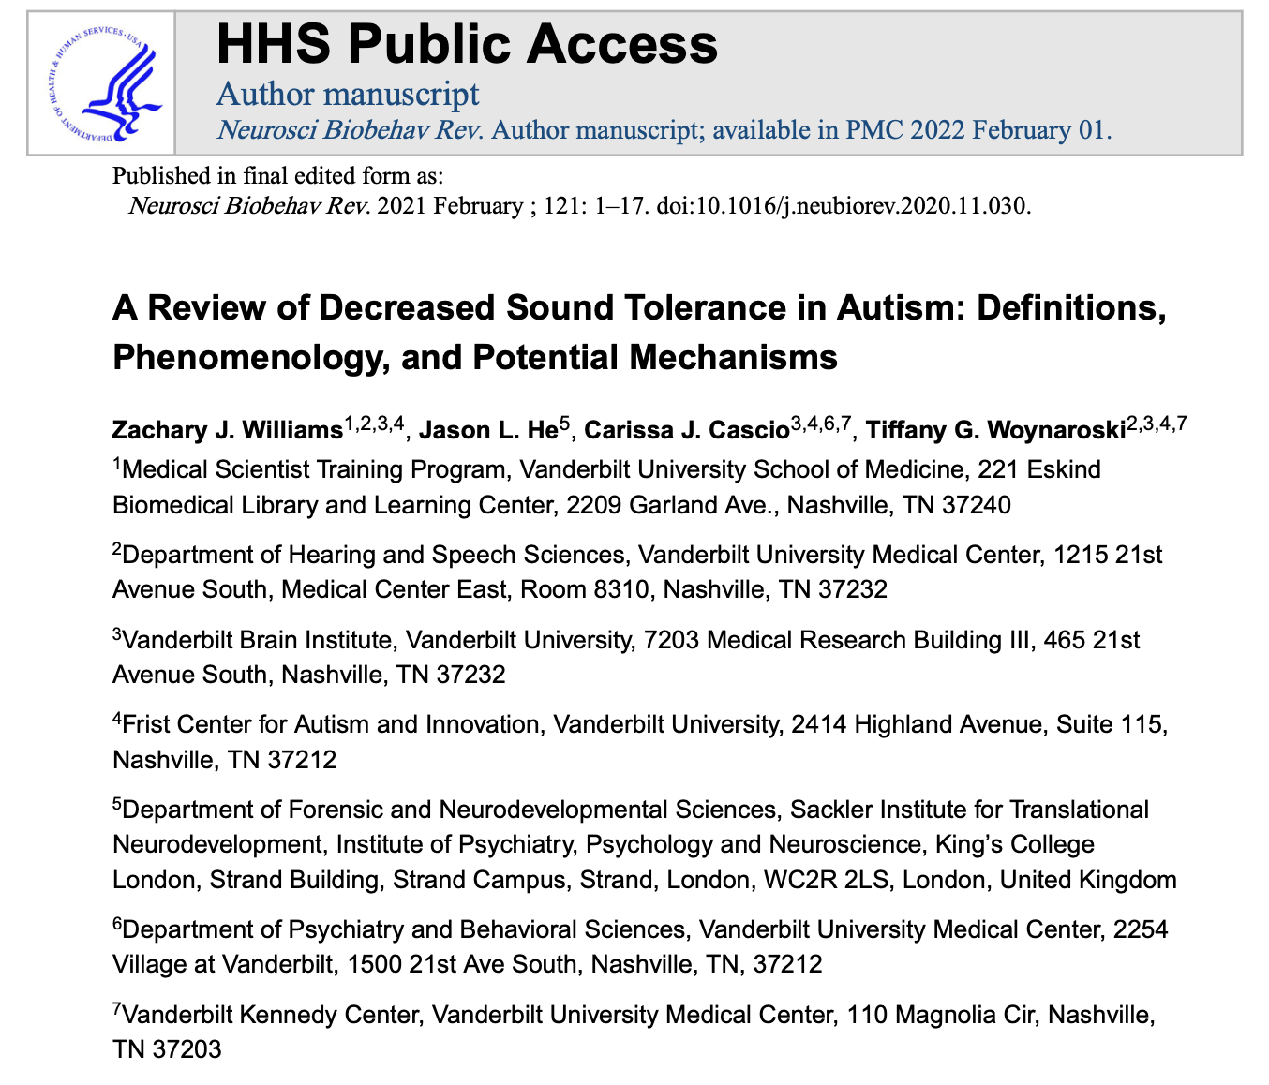
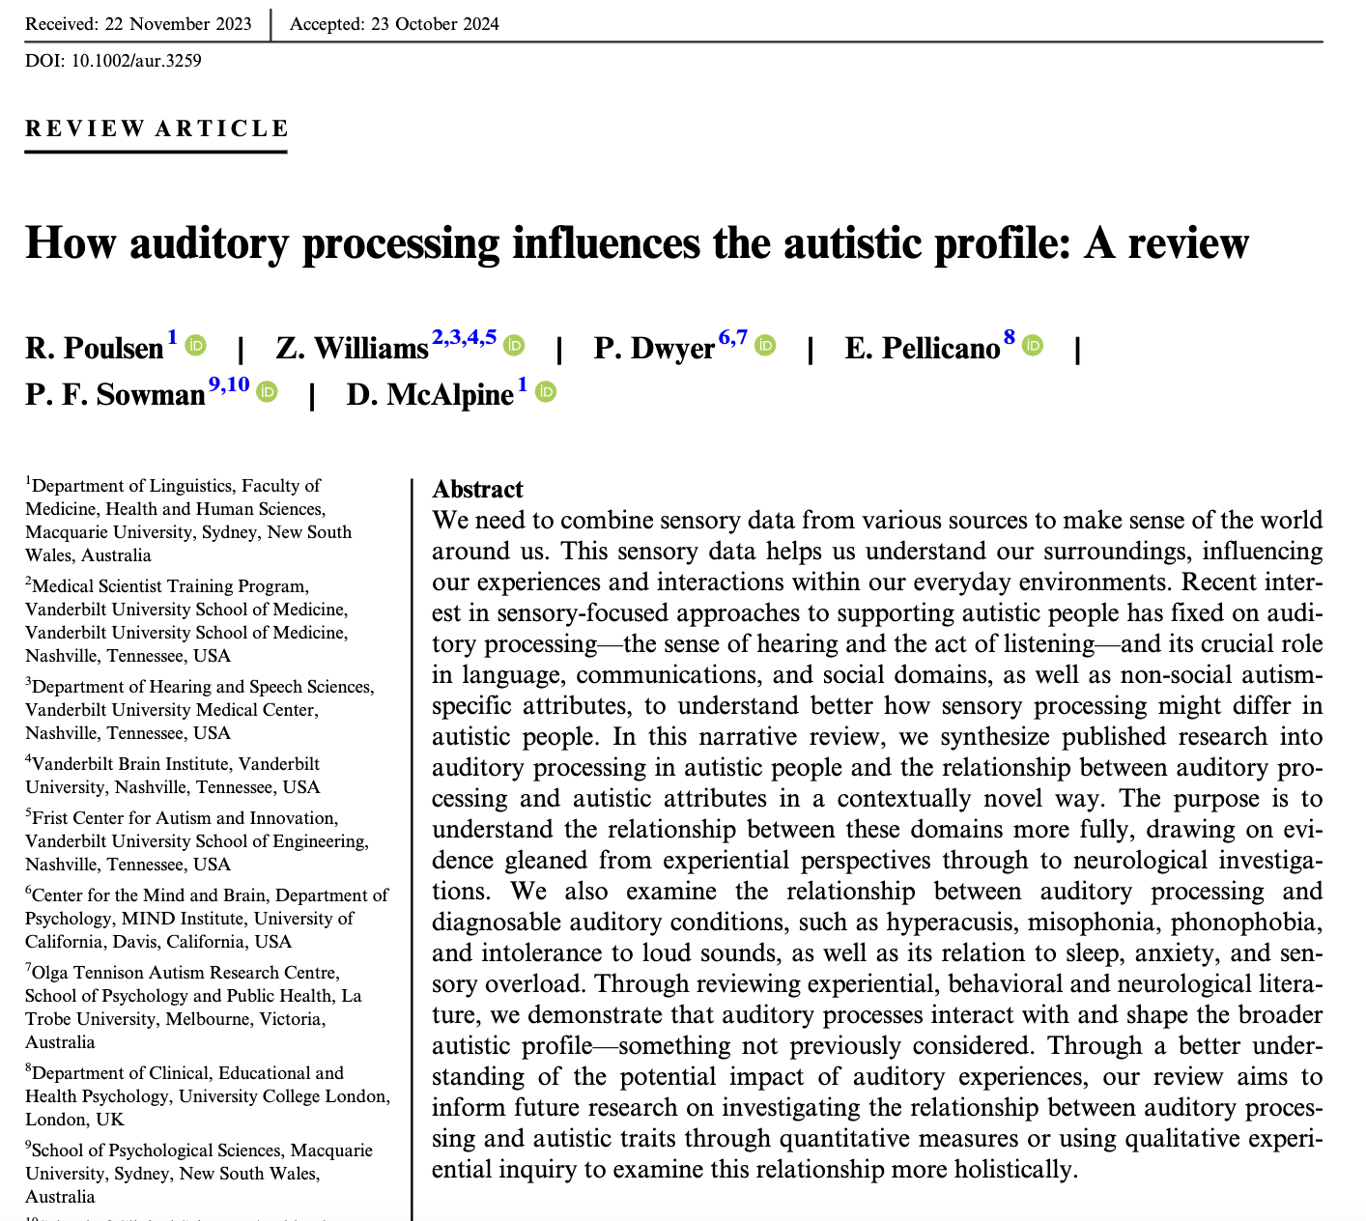
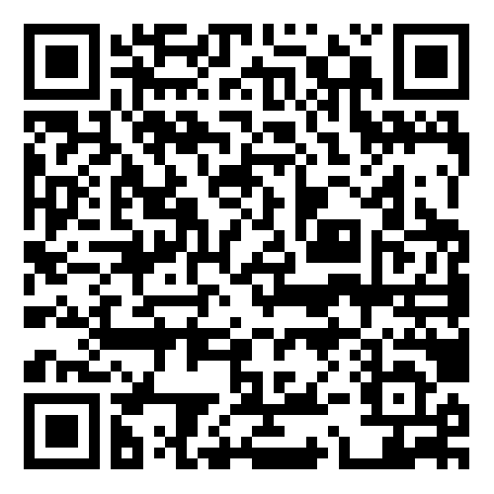
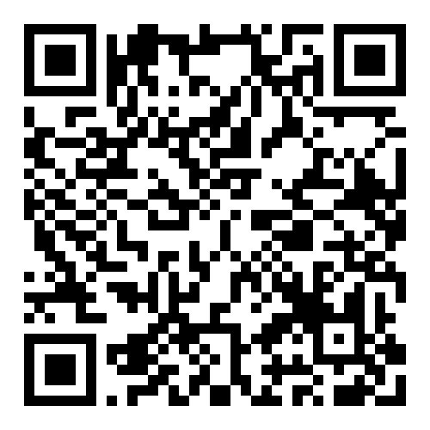
Current prevalence of DST in the autistic population is 38 – 45%, with 50 – 70% of individuals on the autism spectrum having experienced significant DST at some point in their life (e.g., Williams et al., 2021)
DST experiences contribute to workplace challenges, avoidance behavior of certain situations & environments, anxiety, distress, fatigue, etc.
Considered the sensory feature of autism with largest overall impact on quality of life

Slide 14
Sensory Overload → distress experienced by autistic people in response to loud sounds, or too many sound stimuli simultaneously (i.e., adverse environments)…
Can lead to an intense experience of distress, panic, fatigue, desire to escape situation, etc.
Difficulties with DST (hyperacusis, misophonia, phonophobia), sensory overload, & and speech recognition in adverse environments (following target speech while ignoring competing speech and/or noise) may exacerbate social communication differences & limit participation in important communal activities (e.g., workplaces, educational settings, social gatherings, etc.)…
I guess I should disengage & go home 😞
Huh ?????

Slide 15
Relationship between Decreased Sound Tolerance, experiences of sensory overload, & difficulties with speech recognition in adverse environments in autistic individuals is unclear…
However → all three experiences are common in autistic adults, negatively impact participation & access to important activities of daily life, and may compound the core social communication differences that characterize the autism spectrum…
→ Leading us to the purposes of the current study (to be discussed), & the line of investigation being pursued in the Owl Auditory Cognitive Science Lab

Slide 16
Purposes of the Current Study
Evaluate the influence of competing speech maskers with high degrees of informational masking on speech recognition for autistic young adults, due to →
the ecological validity of competing speech (i.e., distracting concurrent voices and conversations) in typical social, vocational, and educational environments
the prevalence of lived experiences related to distraction by competing speech in qualitative reports of autistic adults (e.g., Bendo et al., 2024; Sturrock et al., 2022)
Information Masking
(IM)
Characterize “Speech-in-speech recognition” in autistic young adults

Slide 17
Purposes of the Current Study
Evaluate the ability to use semantic context (i.e., top-down linguistic knowledge) during speech-in-speech and speech-in-noise recognition for autistic young adults
“Glimpsed Representation of Target Speech”
Successful Speech
Recognition ☺
Meaningful & Anomalous target sentences were used to evaluate the influence of sentence-level semantic context on speech recognition in both competing speech and background noise
The influence of sematic context on masked-speech processing in autistic adults is unclear, although prior work suggests deficits using top-down linguistic knowledge to recognize speech in this population (Alcántara et al., 2004)
“top-down” linguistic knowledge

Slide 18
Purposes of the Current Study
Evaluate relationships between SRS-2 scores, self-reported functional listening, and experiences of listening-related fatigue in daily life for both autistic and non-autistic young adults
Data characterizing self-perceived functional listening abilities in the adverse acoustic environment of daily life and listening-related fatigue were collected using valid, reliable, and widely-used self-report tools from audiology/hearing science
This is the first study to incorporate these assessments with autistic adults
Examine potential relationships between self-reported autism characteristics & social communication function, functional listening abilities, and listening-related fatigue

Slide 19
Current Study
Objective Measures
Subjective Measures
Behavioral/laboratory-based speech recognition task
Speech reception thresholds (SRTs) → adaptively measured to evaluate speech-in-speech & speech-in-noise recognition in both autistic and non-autistic young adults with normal hearing
Task Goal → focus on target voice and repeat sentences while ignoring two competing voices or background noise
Objective assessment of speech recognition in simulated adverse environments
Self-report measures of autism characteristics & social communication experiences, listening-related fatigue, and functional listening abilities in daily life
SRS-2: Evaluate social communication function & autism traits, behaviors, & severity (Constantino & Gruber, 2012)
VFS-A: Quantify listening-related fatigue experienced during daily communication (Hornsby et al., 2021)
SSQ: Assess functional listening abilities in the adverse acoustic environments of daily life (Gatehouse & Noble, 2004)

Slide 20
Participants (n = 40)
Qualification Procedures
Autism group (n = 20)
All participants had pure-tone hearing thresholds ≤ 20 dB HL at octave frequencies from 250 Hz to 8000 Hz, as well as at 3000 Hz and 6000 Hz (i.e., all participants had normal hearing [NH] sensitivity)
All participants in the autism group had a clinical diagnosis of autism and identified as a member of the autism community
We chose to have participants self-report autism and autism traits in this study (via SRS-2) to affirm and respect recommendations made by persons in the autism community (Curnow et al., 2023)
20 autistic young adults (7 female, 12 male, 1 non-binary; 18 – 36 years old, M = 24 years, SD = 6 years)
Non-autism group (n = 20)
20 non-autistic young adults (16 female, 4 male, 18 – 33 years old, M = 21 years, SD = 3 years)

Slide 21
Speech Recognition Task
Speech recognition was measured in autistic and non-autistic young adults with normal hearing (NH)
Target sentences were either semantically meaningful or anomalous, and maskers were either two-talker speech or speech-shaped noise
Speech recognition was modeled based on group status (autism and non-autism), masker type (two-talker speech and speech-shaped noise), and target context (anomalous and meaningful)
Four Listening Conditions
Two-talker speech masker
+
Meaningful target sentences
Two-talker speech masker +
Anomalous target sentences
Speech-shaped noise masker
+
Meaningful target sentences
Speech-shaped noise masker
+
Anomalous target sentences

Slide 22
Speech Recognition Task: Target Speech
Target speech materials →
Target sentences from the revised Basic English Lexicon (BEL) sentence corpus (Calandruccio & Smiljanić, 2012 ; O’Neill et al., 2020).
Allows for the manipulation of the level of semantic context provided in the sentences while minimizing other syntactic and lexical differences between the sentence types
M
Semantically meaningful (predictable) sentences →
Ex: “The professor gave an unfair grade” (scorable keywords underlined)
A
Semantically anomalous (nonsensical) sentences →
Ex: “The windows learned in brown secretary” (keywords underlined)

Slide 23

Speech Recognition Task: Target Speech
Fixed Target Talker →
Target speech materials →
Target sentences from the revised Basic English Lexicon (BEL) sentence corpus (Calandruccio & Smiljanić, 2012 ; O’Neill et al., 2020).
Allows for the manipulation of the level of semantic context provided in the sentences while minimizing other syntactic and lexical differences between the sentence types
SRTs:
Meaningful > Anomalous…
But maybe not for autistic young adults based on prior literature??
Meaningful BEL
Anomalous BEL

Slide 24
Speech Recognition Task: Masker Conditions
Speech-shaped noise (SSN) masker
Two-talker speech masker
Energetic Masking (EM) →
“speech-in-noise” recognition
Informational Masking (IM) →
“speech-in-speech” recognition

Slide 25








Speech Recognition Task: Masker Conditions
Two-talker speech masker
Target Talker

Slide 26
Speech Recognition Task
Participants heard both target speech types (meaningful and anomalous sentences) in both masker types (two-talker speech and speech-shaped noise)
Speech Reception Threshold (SRT), defined as the signal-to-noise ratio (SNR) associated with 50% correct keyword recognition, was measured in each listening condition
Lower SRT (dB SNR) indicates better speech recognition performance
Four Listening Conditions
Two-talker speech masker
+
Meaningful target sentences
Two-talker speech masker +
Anomalous target sentences
Speech-shaped noise masker
+
Meaningful target sentences
Speech-shaped noise masker
+
Anomalous target sentences

Slide 27
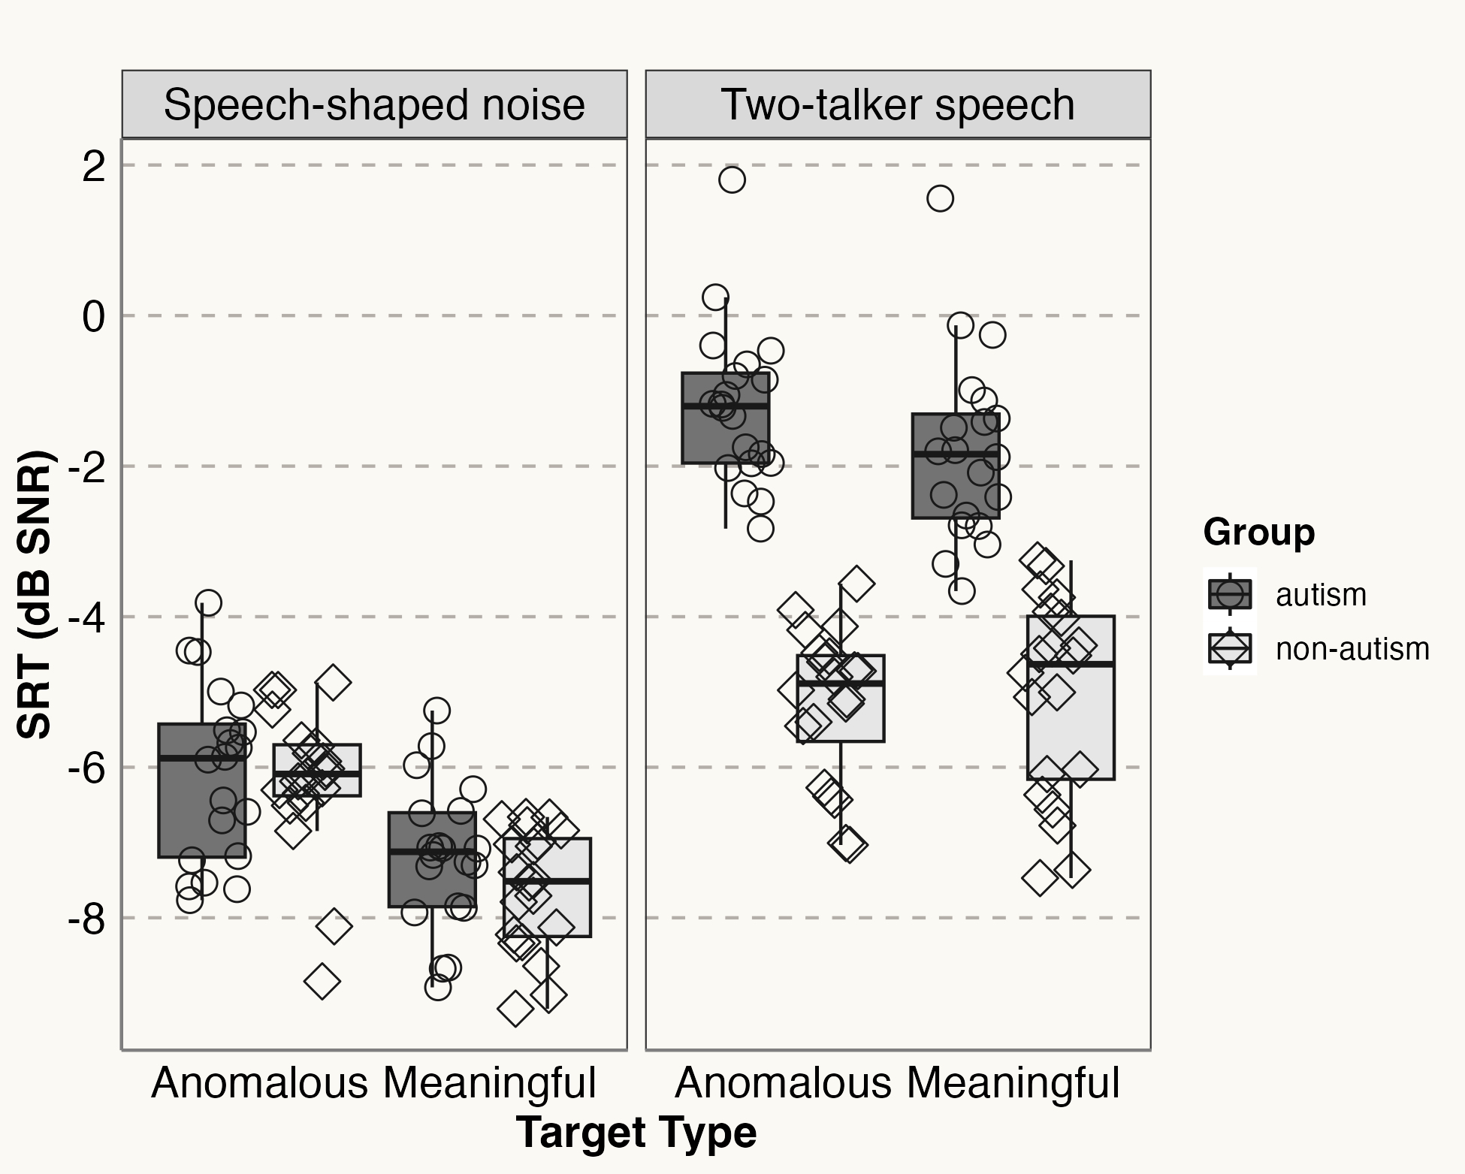
Results
Speech recognition testing revealed significant speech-in-speech recognition challenges for autistic young adults compared to non-autistic peers
Group mean SRTs were about 3.5 dB higher (poorer) for autistic participants in the high IM two-talker speech
No group differences in speech-shaped noise
No difference
No difference

Slide 28
Results
Modest benefits of meaningful target context for both groups in speech-shaped noise (~1.5 dB)
However, only the autistic young adults benefited from meaningful sentence-level context in the two-talker speech (~1 dB)
Overall group differences in SRT across conditions, but primarily due to differences in two-talker speech
No difference

Slide 29
Speech Recognition Task: Results
Autistic young adults with NH displayed significantly poorer speech-in-speech recognition than their non-autistic peers, while speech-in-noise recognition did not differ between groups
Results indicate speech recognition challenges in competing speech backgrounds for young adults on the autism spectrum, which may relate to differences in the ability to perceptually isolate and selectively attend to the target speech in situations with high degrees of informational masking
These behavioral results help validate the listening difficulties reported by autistic adults in the presence of competing talkers in prior qualitative work (e.g., Bendo et al., 2024)
9

Slide 30
Speech Recognition Task: Results
Target speech semantic context improved speech recognition for both groups in speech-shaped noise... However, only participants in the autism group realized benefits of sentence-level semantic context in two-talker speech
Results indicate that autistic young adults can effectively exploit top-down linguistic knowledge to enhance speech recognition in competing speech and noise
“Glimpsed Representation of Target Speech”
Successful Speech
Recognition ☺
“top-down” linguistic knowledge
9

Slide 31
Subjective Measures
Subjective Measures
SRS-2
Self-report measures of autism characteristics & social communication experiences, listening-related fatigue, and functional listening abilities in daily life
SRS-2: Evaluate social communication function & autism traits, behaviors, & severity (Constantino & Gruber, 2012)
VFS-A: Quantify listening-related fatigue experienced during daily communication (Hornsby et al., 2021)
SSQ: Assess functional listening abilities in the adverse acoustic environments of daily life (Gatehouse & Noble, 2004)
Social Responsiveness Scale, Second Edition (SRS-2)
Widely-used self-report tool for characterizing core autism characteristics and behaviors in adults, as well as self-perceived social communication function
65-item SRS-2 self report questionnaire (adult version)
Sum of all items was calculated and converted to T-scores
Higher scores indicate higher autism traits, characteristics, and atypicalities in social communication
Scores ≥ 60 indicate clinical significance

Slide 32
Subjective Measures
Subjective Measures
VFS-A
Self-report measures of autism characteristics & social communication experiences, listening-related fatigue, and functional listening abilities in daily life
SRS-2: Evaluate social communication function & autism traits, behaviors, & severity (Constantino & Gruber, 2012)
VFS-A: Quantify listening-related fatigue experienced during daily communication (Hornsby et al., 2021)
SSQ: Assess functional listening abilities in the adverse acoustic environments of daily life (Gatehouse & Noble, 2004)
The Vanderbilt Fatigue Scale for Adults (VFS-A)
Valid and reliable self-report tool for quantifying listening-related fatigue experienced during daily communication for adults
40-item questionnaire
VFS-A total score was calculated for each participant using standard scoring procedures
Higher VFS-A score indicates higher ratings of listening-related fatigue

Slide 33
Subjective Meaures
Subjective Measures
SSQ
Self-report measures of autism characteristics & social communication experiences, listening-related fatigue, and functional listening abilities in daily life
SRS-2: Evaluate social communication function & autism traits, behaviors, & severity (Constantino & Gruber, 2012)
VFS-A: Quantify listening-related fatigue experienced during daily communication (Hornsby et al., 2021)
SSQ: Assess functional listening abilities in the adverse acoustic environments of daily life (Gatehouse & Noble, 2004)
Speech, Spatial, & Qualities of Hearing Scale (SSQ)
Valid and reliable assessment of an adult’s subjective sense of functional listening abilities in the adverse communication environments of daily life
49-item SSQ for unaided listening
SSQ mean total score was calculated for each participant using standard scoring procedures
Lower SSQ mean total scores indicate greater functional listening difficulties in daily life

Slide 34
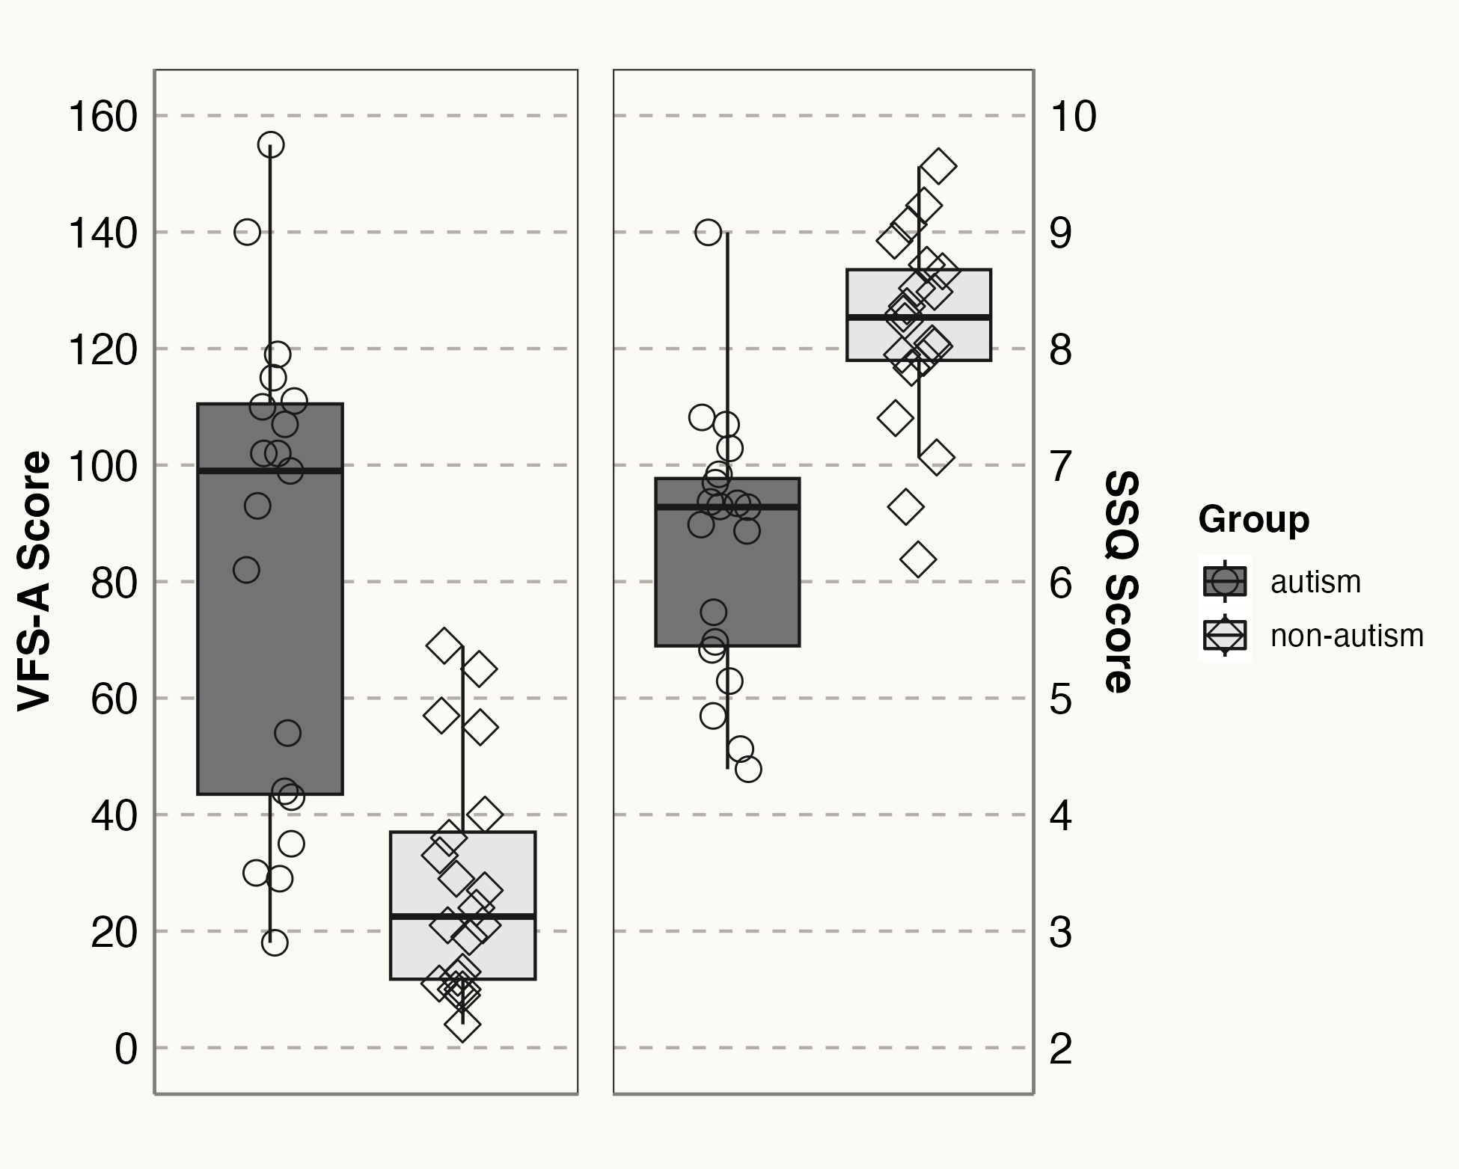
Results
Significant group differences in listening-related fatigue (VFS-A) scores (autism group M = 83.58; non-aut group M = 28.25)
Significant group differences in functional listening abilities (autism group M = 6.31; non-aut group M = 8.16)
Large effect sizes detected for between group differences on both measures

Slide 35
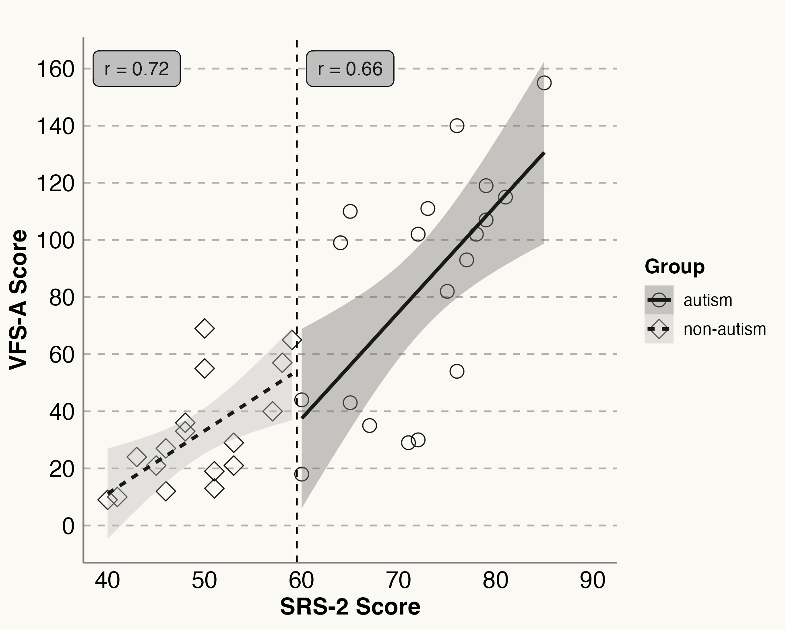
Results
The magnitude of autism traits and social communication challenges (as measured by SRS-2) was strongly associated with VFS-A score in both groups
Participants who scored higher on SRS-2 were more likely to report listening-related fatigue in daily life, regardless of their group status (r = .81)

Slide 36
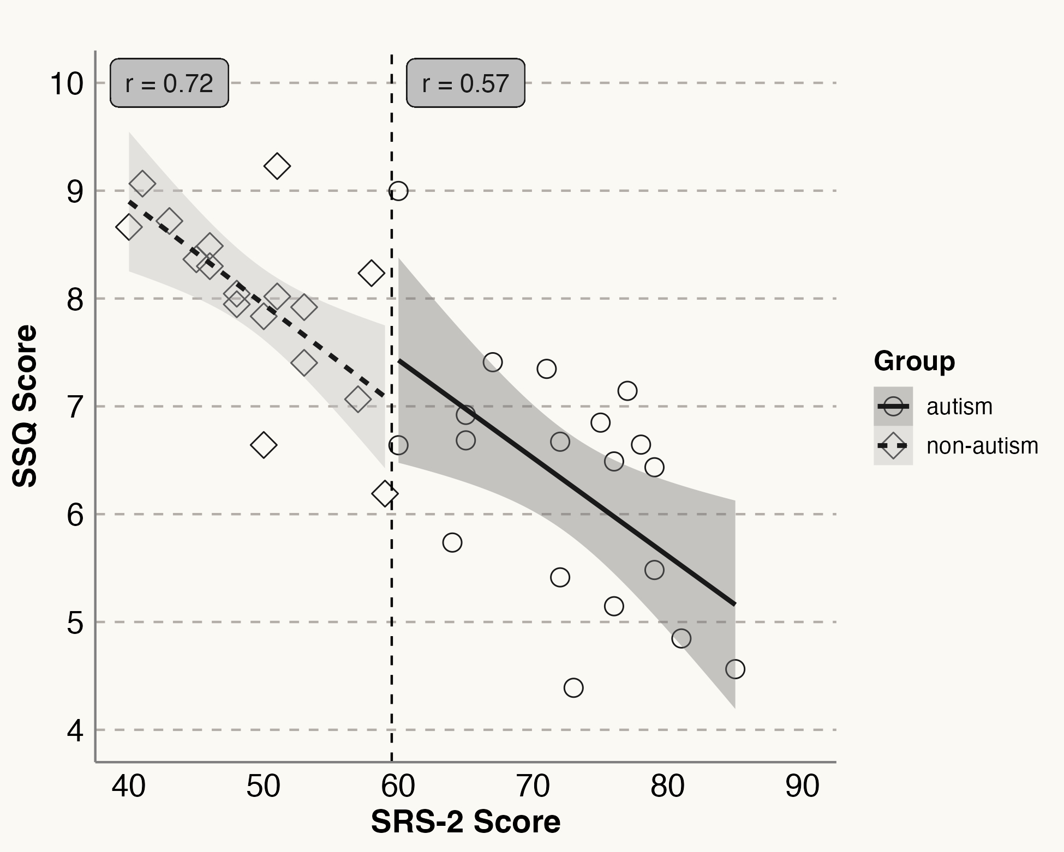
Results
The magnitude of autism traits and social communication challenges (as measured by SRS-2) was strongly associated with SSQ score in both groups
Participants who scored higher on SRS-2 were more likely to report functional listening challenges in daily life, regardless of their group status (r = -.82)

Slide 37
Subjective Measures: Results
Self-reported functional listening difficulties in daily life and experiences of listening-related fatigue were significantly higher in autistic young adults than non-autistic peers
Autism characteristics and self-perceived social communication function (as measured by SRS-2) was strongly associated with both self-reported functional listening abilities and listening-related fatigue in both groups
This novel association between self-perceived social abilities, autism traits and characteristics, and functional listening abilities in young adults with normal hearing requires further investigation…
9

Slide 38
Conclusions & Future Directions
Autistic young adults with normal hearing experience objective speech-in-speech recognition difficulties that correspond with functional listening challenges & experiences of listening-related fatigue in the adverse environments of daily life
Improved awareness of the commonality of listening challenges in autistic adults is essential, as sustained listening effort and difficulty following conversations can lead to the avoidance of noisy situations and social withdrawal
Listening difficulties may compound the core social features that characterize the autism spectrum, and prevent autistic adults from participating fully in society and realizing the best academic, vocational, and socio-emotional outcomes possible
Characterizing the functional listening experiences and abilities of autistic adults, while seeking direct input from individuals in the autism community, is critical to developing evidence-based support strategies that maximize social participation and quality of life

Slide 39
Please feel free to contact me!
Email → Wasiukp1@southernct.edu
SCSU webpage → https://www.southernct.edu/directory/wasiukp1
Lab webpage → https://www.auditory-cognitive-science.com/contact
Dr. Peter A. Wasiuk, AuD, PhD, CCC-A
Assistant Professor @ SCSU
Department of Communication Disorders

